Slide 1
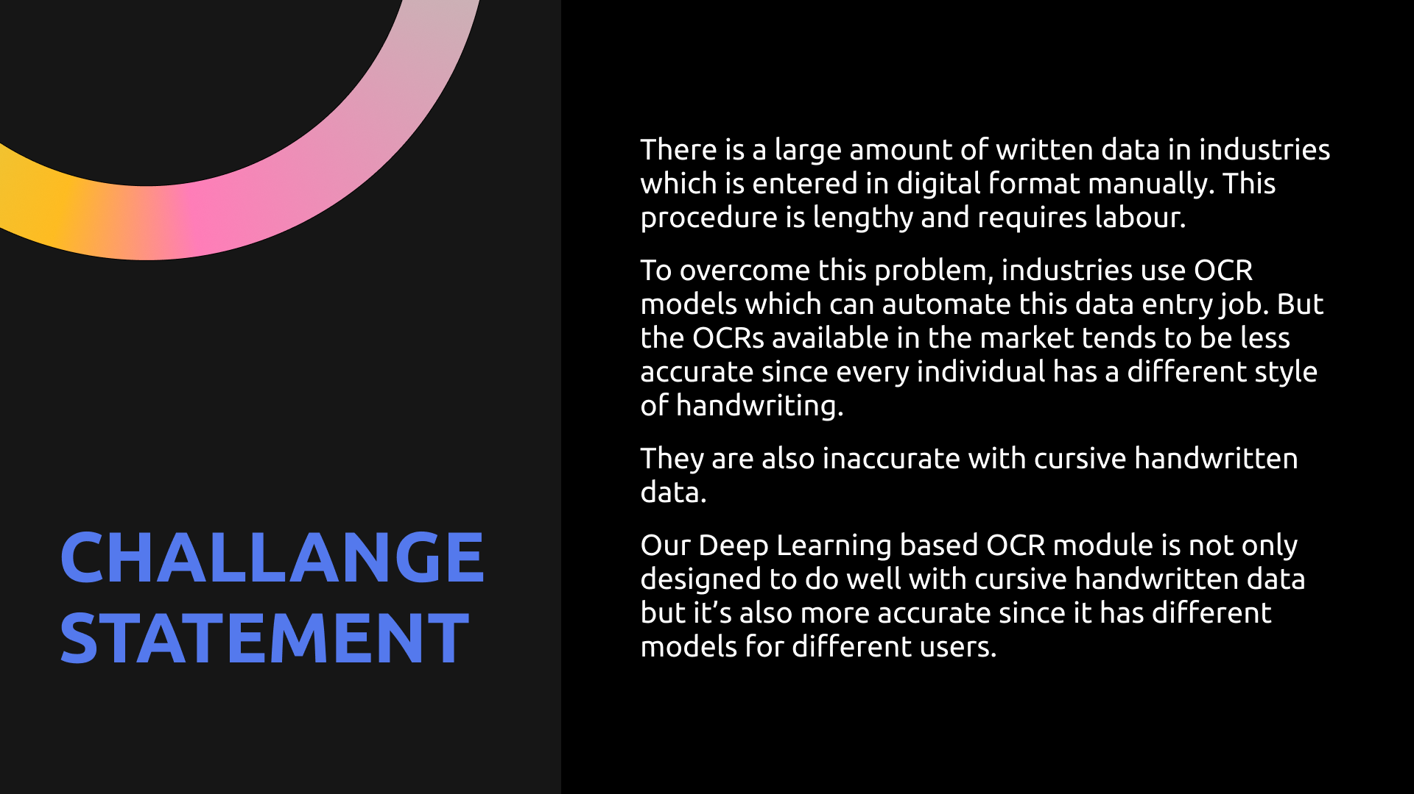
OBJECTIVES-
Object detection: The ability to identify and locate individual packages in a group of packages.
Pick and place: The ability to pick up a package from a group of packages and place it in a specific location.
Orientation control: The ability to ensure that the shipment barcode is present on top of the package when it is dropped in the Drop-Zone.
Flipkart GRID 5.0
Robotics Challenge
GRID BOT

Slide 2
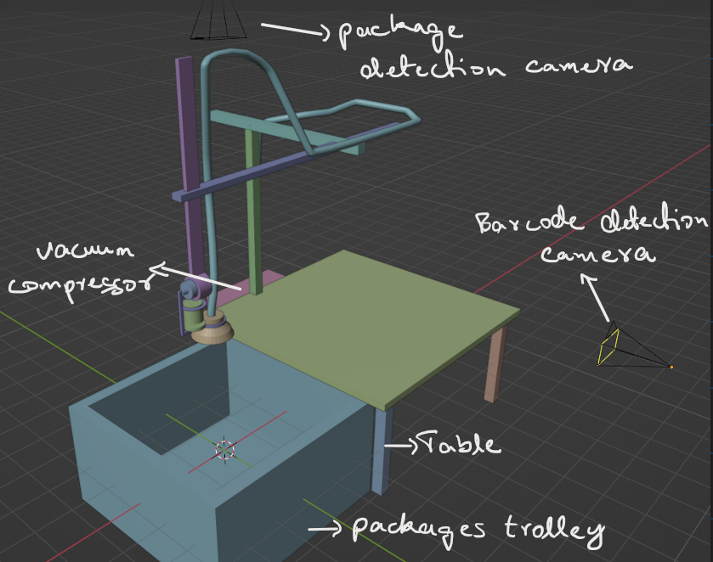
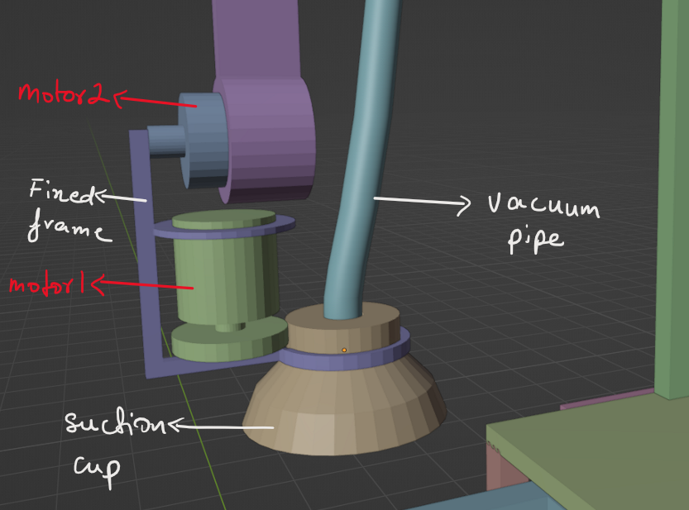
DESCRIPTION
GRID Bot, a revolutionary robot designed to pick up packages from a trolley and place them in a designated drop zone.

Slide 3
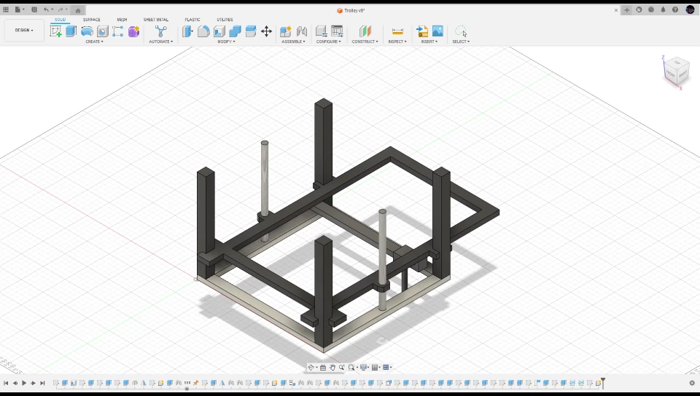

Slide 4
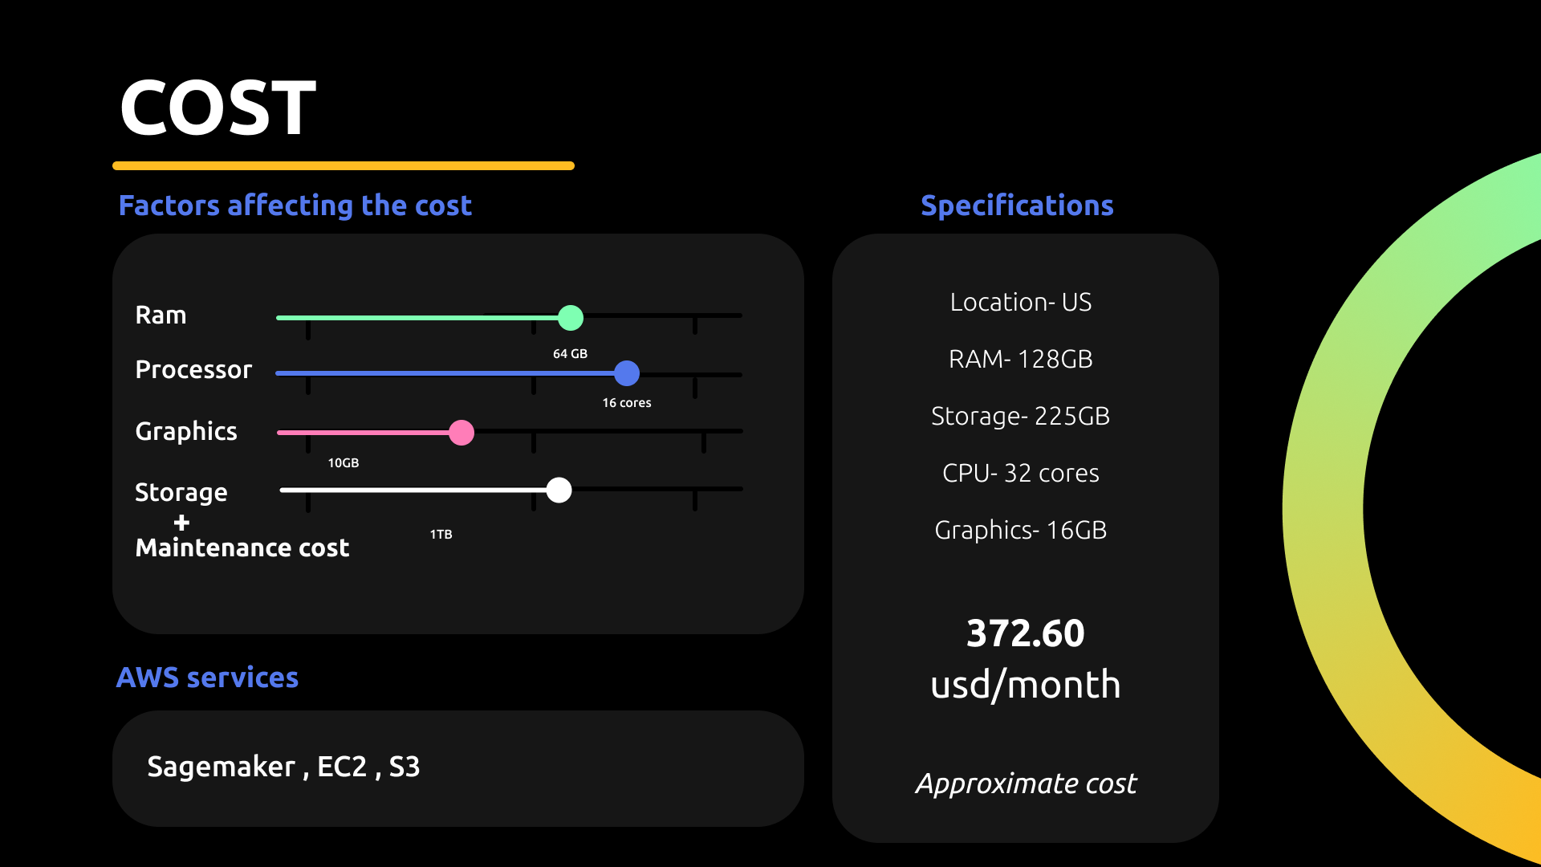
BOM
Component | Quantity | Price
Nema23 (30.61 kg-cm) | 1 | ₹ 2,480
Nema17 (7.2 kg-cm) | 2 | ₹ 2,400
Mount Brackets | 3 | ₹ 700
Nema17 driver A4988 | 2 | ₹ 146
Nema23 driver TB6600 | 1 | ₹ 865
GT2 Timing Belt 10m | 1 | ₹ 650
GT2 Timing Pulleys | 8 | ₹ 1,208
2020 Aluminium Extrusion 1m | 10 | ₹ 5,490

Slide 5

CONTINUED..
Component | Quantity | Price
AC-DC 12V 2A power supply | 2 | ₹ 598
AC-DC 24V 4A power supply | 1 | ₹ 702
LM rail 1m | 1 | ₹ 3,525
RaspberryPi 3b+ | 1 | ₹ 4905
Vacuum Cup | 1 | ₹ 1062
8KG Lifting Solenoid Electromagnet | 1 | ₹ 266
Miscellaneous |  | ₹ 5000
Total- 30,000

